Slide 1

C++ Pattern Matching Library
Yuriy Solodkyy · Gabriel Dos Reis · Bjarne Stroustrup
Monday, September 26, 2011 INRIA

Slide 2
Motivation
Visitor Design Pattern Problems
We are looking for something
Intrusive
Hinders extensibility
Specific to hierarchy
Control inversion
Too much boilerplate code
Hard to teach to novices
More expressive
As fast or faster
Extensible
Portable across C++ implementations
A solution within C++, not an extension

Slide 3
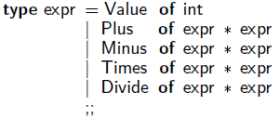
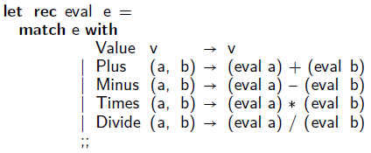
Solution by Example
// Type definitions:
struct Expr { virtual ~Expr(){} }; struct Value : Expr { int value ; };
struct Plus : Expr { Expr* e1; Expr* e2; };
struct Minus : Expr { Expr* e1; Expr* e2; };
struct Times : Expr { Expr* e1; Expr* e2; };
struct Divide: Expr { Expr* e1; Expr* e2; };
// Evaluator for expressions:
int eval(const Expr* e)
{
Match(e)
Case(Value, n) return n;
Case(Plus, a,b) return eval(a)+eval(b);
Case(Minus, a,b) return eval(a)-eval(b);
Case(Times, a,b) return eval(a)*eval(b);
Case(Divide,a,b) return eval(a)/eval(b);
EndMatch
}
// Name bindings: not needed for type switch
template <> struct bindings<Value>
{ CM(0,Value::value); };
template <> struct bindings<Plus>
{ CM(0,Plus::e1); CM(1,Plus::e2); };
Name bindings done by OCaml compiler
Notes:
Mention bindings are only needed for parameters, not for type switch
C++ compiler will be generating those in a language solution
Similar to Tom’s user-provided mappings

Slide 4
A library
Use with any standards conforming C++ compiler
Written in C++ (no compiler hacking necessary)
Allows for experimentation
Fast Type Switch +
Expressive Pattern Matching
Close or faster than visitors
Open to extensions
including those in DLLs
Non-intrusive
retroactively applied to any polymorphic or tagged hierarchy
Supports multiple inheritance
both repeated & virtual
Better addresses expression problem than visitors
does not lock hierarchy
Unified syntax
Redundancy checking
Ideas can be used for other languages
Primitive patterns
Constructor patterns
Type patterns
Nested patterns
Guard patterns
Generalized n+k patterns
Views
Notes:
Mention encodings, but say we won’t look into them
Stress it’s an intermediate solution to experiment,
Many things you’ll see are only that way because we are in a library setting where less things are possible

Slide 5

Performance Highlights
// Example of forwarding in visitors
class SomeVisitorInterface
{
virtual void visit(const BaseClass&) = 0;
virtual void visit(const DerivedClass& d) {
visit(static_cast<const BaseClass&>(d));
}
};
Each successive call in a benchmark is made to:
Repetitive: object of the same type
Sequential: object of a different type
Random: object of a randomly chosen type
Notes:
Say about benchmarks, then encoding and syntax
Special generally faster than Unified
Forwarding faster than without it
Visual C++ is actually better
Mention PGO and branch hinting

Slide 6
Feedback?
What can be interesting to broader audience?
Any related work we should discuss/compare?
Anything we failed to take into account?
Any additional experiments or tests needed?
Wrong/misused/better terminology?

Slide 7
Expression Problem
Expression Problem: a problem of supporting modular extensibility of both data and functions at the same time in one programming language.
Independently Extensible Solutions
C++ specifics
Extensibility in both dimensions
Strong static type safety
No modification or duplication
Separate compilation
Independent extensibility
Nominative subtyping
Multiple inheritance
Dynamic linking
Multiple versions of a class
Notes:
Extensibility in both dimensions:
It should be possible to add new data variants, while adapting the existing operations accordingly. It should also be possible to introduce new functions.
Strong static type safety:
It should be impossible to apply a function to a data variant, which it cannot handle.
No modification or duplication:
Existing code should neither be modified nor duplicated.
Separate compilation
Neither datatype extensions nor addition of new functions should require re-typechecking the original datatype or existing functions. No safety checks should be deferred until link or runtime.
Independent extensibility:
It should be possible to combine independently developed extensions so that they can be used jointly.

Slide 8
Type Switching
B& b = *new D;
Type Testing
if (dynamic_cast<Di*>(&b)!=nullptr)
Type Identification
Di& d = dynamic_cast<Di&>(b);
Type Switching
switch (b)
{
case D₁: s₁; // b is actually D₁
...
case D_{n}: s_{n}; // b is actually D_{n}
default: s_{d}; // none of the above
}
First-fit semantics
will evaluate the first statement s_{i} such that D_{i} is a base class of D
Best-fit semantics
will evaluate the statement corresponding to the most derived base class D_{i} of D if it is unique (subject to ambiguity)
The-only-fit semantics
will only evaluate statement s_{i} if D_{i} = D.
All-fit semantics
will evaluate all statements s_{i} whose guard type D_{i} is a subtype of D
Any-fit semantics
might choose non-deterministically one of the statements enabled by all-fit
Combinations etc.
Notes:
Following Emir’s terminology
Dynamic_cast is analog of InstanceOf with cast functionality

Slide 9
Type Switching: Extensible or Fast
Needs to be comparable to visitors to be adopted
28 cycles for hot cache and 54 cycles for cold (Core i5 460M, 2.53GHz)
dynamic_cast is slow
Exception handling based type switching is even slower
Classes can be freely extended in C++
Organized in class hierarchies
No sealed classes
In DLL, independently of the main program
There can be several versions of the same class
Naïve but Extensible Solution
if (D₁* derived = dynamic_cast<D₁*>(&b)) s₁; else
if (D₂* derived = dynamic_cast<D₂*>(&b)) s₂; else
...
if (D_{n}* derived = dynamic_cast<D_{n}*>(&b)) s_{n}; else s_{d};
Notes:
Mention ADT in functional languages are inherently closed
Mention extensible type sums vs. hierarchical extensible type sums

Slide 10
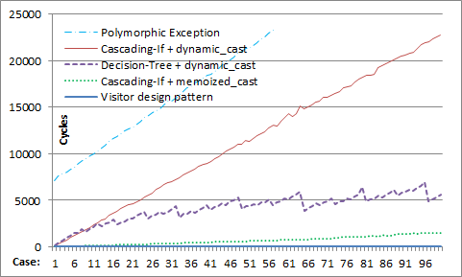
Type Switching: Extensible or Fast
Notes:
Mention we had match statements of 5,7,8,10,15,17,30 and 63 case clauses each, with 160 total classes

Slide 11
Type Switching: Extensible or Fast
Fast Dynamic Cast
Has limitations on size of representable hierarchies
Requires decision-tree implementation
One Tag per Class
Useless for switching on base classes
Tags may be far apart
Requires integration for independent DLL extensions
Class Precedence List
Useless for implementing first-fit semantics
Linearizes hierarchy
Cost proportional to the number of base classes
Notes:
A 32-bit integer is estimated to be able to represent 7 levels of a class hierarchy that forms a binary tree (255 classes), 6 levels of a similar ternary tree hierarchy (1093 classes) or just one level of a hierarchy with 9 base classes -- multiple inheritance is the worst case scenario of the scheme that quickly drains its allocation possibilities.
Chinese reminders to store offsets

Slide 12
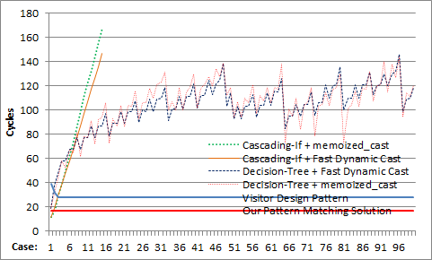
Type Switching: Extensible or Fast
Notes:
Only jump-table implementation of a switch can compete with visitors, binary tree cannot!
Binary tree hierarchy

Slide 13
Predicate Dispatching Switch
Given a set of predicates P₁, …, P_{n} without observable side effects and an argument x, execute the statement s_{i} that corresponds to the first|most specific|all|any predicate Pi(x) that is true or s_{d} if none is true.
switch (x)
{
case P₁(x): s₁;
...
case P_{n}(x): s_{n};
default: s_{d};
}
Notes:
Predicates can be seen as characteristic function of a type
Logical implication between predicates can be seen as subtyping

Slide 14
Memoization Device
typedef decltype(x) T;
static std::unordered_map<T,int> jump_target_map;
switch (int& target = jump_target_map[x])
{
default: // entered when we haven't seen x yet
if (P₁(x)) { target = 1; case 1: s₁; } else
if (P₂(x)) { target = 2; case 2: s₂; } else
...
if (P_{n}(x)) { target = N; case N: s_{n}; } else
{ target = N+1; case N+1: s_{d}; }
}
Uses memory proportional to the number of values seen
Values can often be grouped into equivalence classes with respect to outcome of predicates
Cascading-if can be replaced with a decision tree when some predicates imply/exclude others
Notes:
Unordered_map is a hash_map
Static makes it global
Writing target writes back into the hash_table
Removing else will make it all-fit

Slide 15
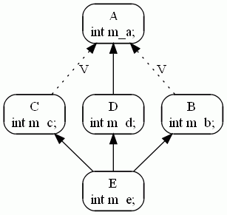
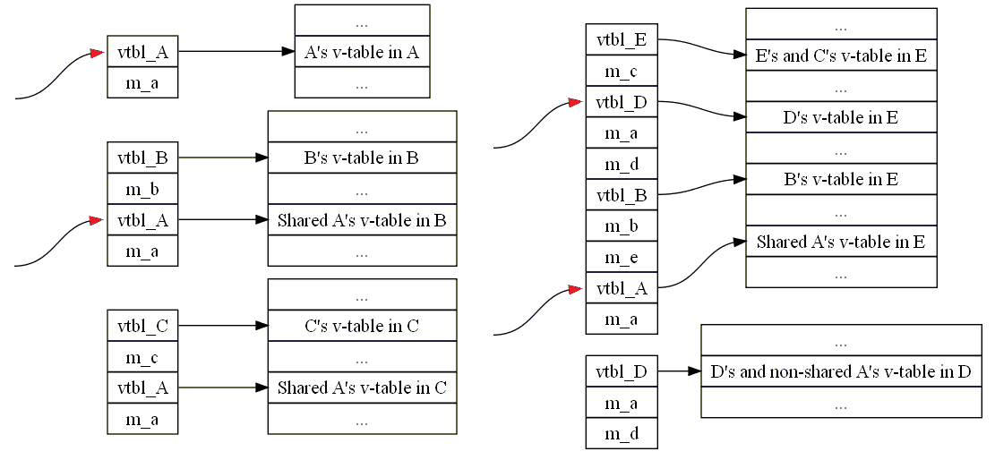
Virtual Table Pointers
pair<ptrdiff_t,size_t>& info = jump_target_map[vtbl];
if (tptr = dynamic_cast<const Di*>(p))
{
if (info.second == 0)
{
info.first = intptr_t(tptr)-intptr_t(p);
info.second = 42;
}
case 42:
auto matched = adjust_ptr<Di>(p,info.first);
si;
Notes:
Theorem: In an object layout that adheres to C++ ABI, virtual table pointers of two
objects of the same static type are equivalent if and only if they have the same
inheritance path in the same most-derived type*
Corollary: Results of dynamic_cast can be reapplied to a different instance from within the same sub-object.

Slide 16
Tagged Classes
User designates a member that uniquely identifies derived class
communicated to library via a selector in bindings
The-only-fit becomes a switch on tags
and is as efficient as Ocaml’s match against ADT
To implement Best-fit, we build CPL
Class Precedence List (CLOS etc.)

Slide 17
Comparing Both Approaches
Vtbl Memoization
Class Precedence List
Works out of the box on polymorphic classes
No integration needed
Always based on jump table
Amortized constant time
First-fit and best-fit
Subject to cache collisions
Kind selector and kind values have to be specified
Might require integration
Might become decision tree
O(Height of hierarchy)
Best-fit
Notes:
Only jump-table can compete with visitors

Slide 18
Pattern Matching Library
Based on Expression Templates
compile-time technique in C++ to build expression trees and give them user-defined semantics
syntactic choices are driven by possibilities of ET
Naïve backtracking approach
no help from compiler in optimizing the order of tests
we might provide few simple ET-based optimizations
we give more control to the user to compensate
Accentuates on expressivity, not speed
Interacts with fast type switching in a limited way

Slide 19
Bindings
template <> struct bindings<Shape> {
KS(Shape::kind); // Kind selector
KV(Shape::unknown_shape); // Kind value
CM(0,Shape::area); // Class member
};
template <typename T> struct bindings<std::complex<T>> {
CM(0,std::complex<T>::real); // 1st matching position
CM(1,std::complex<T>::imag); // 2nd matching position
};
template <typename X, typename Y>
struct bindings<std::pair<X,Y>> {
CM(0,std::pair<X,Y>::first); // 1st matching position
CM(1,std::pair<X,Y>::second);// 2nd matching position
};
A way to tell the library which values, types or class members from the user’s class hierarchy satisfy certain requirements.
Used to specify:
Binding of members to matching positions
Member holding kind
Kind value of a given class
Base class
Class Precedence List
Expected frequency
etc.

Slide 20
Patterns
Patterns are functional objects in our library:
they can be applied to a subject
test whether subject matches pattern
bind variable patterns as side effect
Example: Primitive Patterns
variable<int> x; // Variable pattern
value<int> c(42); // Value pattern
wildcard _; // Wildcard pattern
x(7); // Returns true, sets x to 7
c(7); // Returns false as 7 != 42
_(7); // Returns true. Optimized to not access any member

Slide 21
Constructor and Type Patterns
Syntactically look the same:
match<T>(P₁,…,P_{n})(S)
T = S – Constructor Pattern
T ≠ S – Type Pattern
Example:
complex<float> z(1.0,2.0); float x,y,r;
const Shape& s = Circle(0,0,4);
if (match<complex<float>>(x,y)(z)) ... // Constructor pattern
if (match<Circle>(_,0,r)(s)) ... // Type pattern
Notes:
Note that value and variable patterns are now implicit inside match expression

Slide 22
Guard Patterns
Lazily evaluated conditions
that can be put anywhere a pattern is expected
operator |= is chosen only because of low precedence
Example:
variable<double> r, g, b;
auto P = match<RGB>(r, g |= g < r, b |= b < g+r) |= r+g+b < 0.5;
P(RGB(0.0,0.1,0.2)); // Returns true
Arguments are bound left-to-right

Slide 23
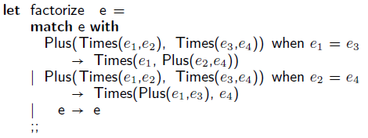
Nested Patterns
struct Expr { virtual ~Expr(){} }; struct Value : Expr { int value ; };
struct Plus, Minus, Times, Divide : Expr { Expr* exp1; Expr* exp2; };
// Factorization of expressions
const Expr* factorize(const Expr* e)
{
variable<const Expr*> e1, e2, e3, e4;
if (match<Plus>( match<Times>(e1,e2), match<Times>(e3 |= e1==e3,e4)
)(e))
return new Times(e1, new Plus(e2,e4));
if (match<Plus>( match<Times>(e1,e2),
match<Times>(e3,e4 |= e2==e4) )(e))
return new Times(new Plus(e1,e3), e4);
return e;
}
Notes:
We can add equivalence patterns, but don’t cause we don’t know how useful or frequent they are and don’t want to slow common path
match<Times>(e1,e2) is a common pattern that can be taken out, but as is will be recreated
Types syntax is not real C++, just to shorten

Slide 24
n+k Patterns
Generalized for other operations
including user-defined functions
but with at most one variable per expression
Example: Fast Fibonacci
int fib(int n)
{
variable<int> m;
if (match<int>(1)(n)) return 1;
if (match<int>(2)(n)) return 1;
if (match<int>(2*m)(n)) return sqr(fib(m+1)) - sqr(fib(m-1));
if (match<int>(2*m+1)(n)) return sqr(fib(m+1)) + sqr(fib(m));
}
Requires user to provide solvers
function-like object with overload for each position
Example: Solver for multiplication
template <> struct solver<multiplication>
{
template <class A, class B> // 1st arg
bool operator()(A& a, const B& b, const decltype(a*b)& r) {
a = r/b; // a*b == r => a == r/b
return a*b == r;
}
template <class A, class B> // 2nd arg
bool operator()(const A& a, B& b, const decltype(a*b)& r) {
b = r/a; // a*b == r => b == r/a
return a*b == r;
}
};
Notes:
We do not propose them, but just show they fit into the library and we can experiment with them
When no bindings are provided, the default one is to match the whole object
inspired by similar objects we did for approximating backward semantics in an abstract interpretation framework

Slide 25
Views
We allow multiple bindings for the same type
necessary for handling discriminated unions
useful for other types too
implemented as additional argument of bindings meta-function, called layout
Views are coupling of type and layout
with some support from the rest of the library
Implemented with a view<T,l> template
// Introduce layouts
enum { cartesian = default_layout, polar };
// Define bindings with them
template <typename T> struct bindings<std::complex<T>, polar>
{ CM(0,std::abs<T>); CM(1,std::arg<T>); };
// Define views
template <typename T>
using Cartesian = view<std::complex<T>>;
template <typename T>
using Polar = view<std::complex<T>, polar>;
...
std::complex<double> c;
double a,b,r,f;
if (match< complex<double>>(a,b)(c)) ...
if (match<Cartesian<double>>(a,b)(c)) ...
if (match< Polar<double>>(r,f)(c)) ...
Notes:
Layouts were initially needed to handle discriminated unions.
Then became useful for other types
And eventually helped with views

Slide 26
Limitations
Fast Type Switch
Expressive Pattern Matching
Uses macros
Extra syntactic burden
Single-threaded for now
Some encoding-specific semantic differences
Some caveats to be explained to novices
Single subject for now
User-controlled order of evaluation
Potential re-evaluation of common sub-expressions
Some caveats to be explained to novices
These limitations are due to library approach only and won’t matter for compiler implementation
Notes:
Mention Case allows only names of variables,
While implicit value and variable patterns are only allowed in match expression

Slide 27
Related Work
Extensible Visitors with Defaults (Zenger and Odersky)
require integration and dynamic_cast, easier with virtual inheritance
Tom (Moreau, Ringeissen and Vittek)
broader goals – term rewriting. InstanceOf-like type switching
Predicate Dispatching and Pattern Matching (Ernst, Kaplan and Chambers)
InstanceOf-like predicate for class membership
Haskell’s Open Data Type and Open Functions (Loh and Hinze)
assumes closed world – semantics is given by translation into a single module without open data types
Polymorphic Variants in OCaml (Garrigue)
different subtyping relation, extensible but not hierarchical sum types
Extensible Types of ML2000 (ML 2000 Working Group)
saw their semantics, but not much on implementation besides similarities with exception handling
Pattern Matching in Scala (Emir)
type switching is on tags for sealed classes, otherwise InstanceOf+decision tree
Pattern Matching in Pizza
need to read more
Compilation and Optimization of Pattern Matching (Le Fessant, Maranget)
mostly rely on InstanceOf like predicate combined with decision tree or optimized backtracking automata
Type Dispatch for Named Hierarchical Types (Glew)
theory behind tag-based type switching, similar to our CPL approach

Slide 28
Thank You
Questions?

Slide 29
Vtable Memoization
typedef std::pair<ptrdiff_t,size_t> type_switch_info;
static std::unordered_map<intptr_t, type_switch_info> jump_target_map;
intptr_t vtbl = *reinterpret_cast<const intptr_t*>(p);
type_switch_info& info = jump_target_map[vtbl];
const void* tptr;
switch (info.second)
{
default:
...
if (tptr = dynamic_cast<const Di*>(p))
{
if (info.second == 0)
{
info.first = intptr_t(tptr)-intptr_t(p);
info.second = 42;
}
case 42:
auto matched = adjust_ptr<Di>(p,info.first);
si;
}
...
}
Still about 50% slower than visitors
vtblmap<T> = unordered_map + cache
Cache uses structure of vtbl pointers:
00000001001111100000011001001000
00000001001111100000011001011100
00000001001111100000011001110000
...
00000001001111100000011111011000
00000001001111100000011111101100 00000001001111100000011XXXXXXX00
Presence of DLLs changes higher bits:
0XXX00X1X0XXXXXX0XXXXXXXXXXXXX00
Lower bits change more often & in compact regions

Slide 30
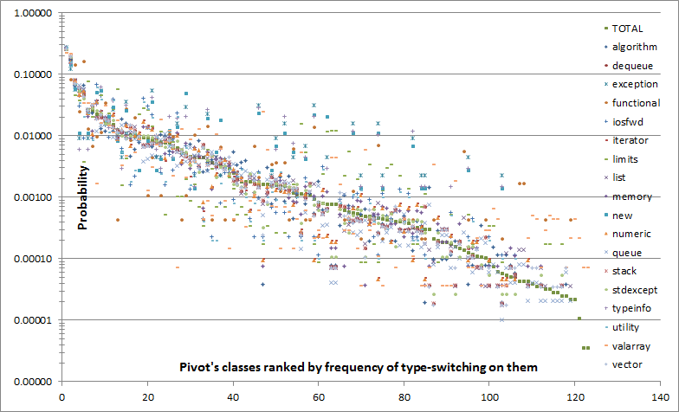
Minimization of Conflicts

Slide 31
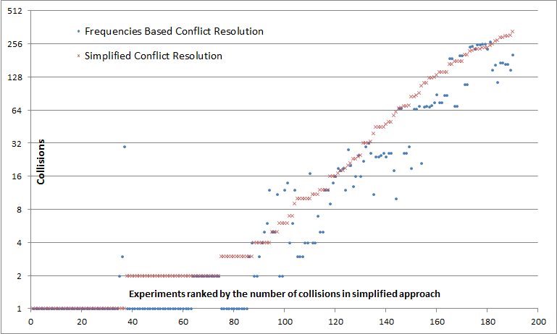
Effect of Conflicts Minimization

Slide 32
CPL Based Type Switch
const size_t* taglist = 0;
size_t attempt = 0;
size_t tag = object->tag;
ReMatch:
switch (tag)
{
default:
if (!taglist) taglist = get_taglist(object->tag);
tag = taglist[++attempt];
goto ReMatch;
case end_of_list: break;
case bindings<D₁>::kind_value: s₁;
...
case bindings<D_{n}>::kind_value: s_{n};
}

